Slide 1
Crafting & Compelling Website Analysis, Audit and Recommendations
SUBMITTED BY
D.BHUVANA

Slide 2
CONTENT
Company
Product and Service Descriptions
Website Platform Identification
Responsive Design Testing
Website Mistakes Identification
Best Practices List
Website Design

Slide 3


Slide 4
Tata Consultancy Services (TCS) is an Indian multinational company specializing in information technology services and consulting. Headquartered in Mumbai, it is a part of the Tata Group and operates in 150 locations across 46 countries.
Tata Consultancy Services Limited, originally known as Tata Computer Systems, was established in 1968 by Tata Sons Limited
In 1980, TCS established India's first dedicated software research and development center, the Tata Research Development and Design Centre (TRDDC), located in Pune.

Slide 5
Tata Consultancy Services (TCS) offers a wide range of products and services designed to address various business and technology needs. Key offerings include:
IT Services:
TCS provides IT services including software development, systems integration, and IT consulting. These services support business operations through custom application development, systems integration, and strategic technology guidance.
Business Process Outsourcing (BPO):
TCS offers Business Process Outsourcing (BPO) services that involve managing and executing business processes such as finance and accounting, human resources, and customer service operations.

Slide 6
Cloud Computing:
TCS delivers cloud computing services including infrastructure as a service (IaaS), platform as a service (PaaS), and software as a service (SaaS). These services help organizations manage IT resources and applications flexibly.
Digital Transformation:
TCS supports digital transformation with technologies such as artificial intelligence (AI), machine learning (ML), and the Internet of Things (IoT). These solutions assist organizations in modernizing their operations and enhancing customer engagement.
Enterprise Solutions:
TCS offers enterprise solutions including enterprise resource planning (ERP), customer relationship management (CRM), and business intelligence (BI) systems. These solutions aim to optimize business processes and support decision-making.

Slide 7



Congnitive Business Operations
Artificial intelligence
Cloud

Slide 8



Consulting
Data & Analytics
Enterprise Solutions

Slide 9

Website Platform Identification

Slide 10
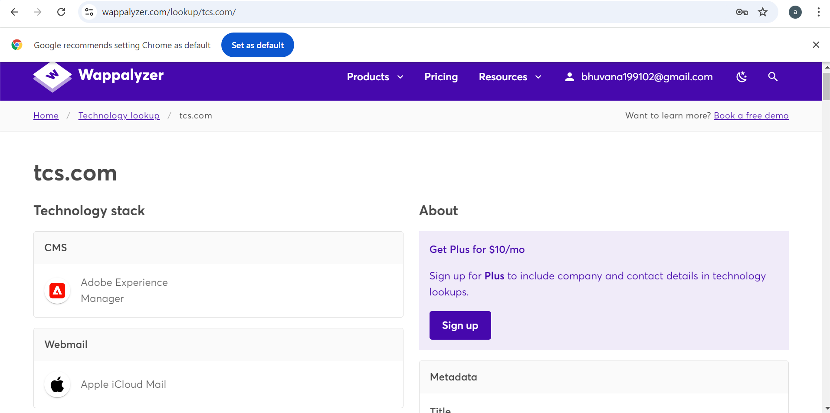

Slide 11
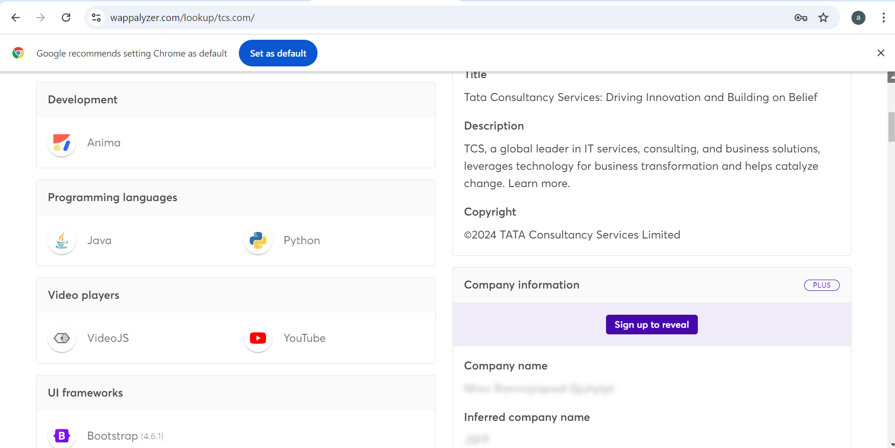

Slide 12
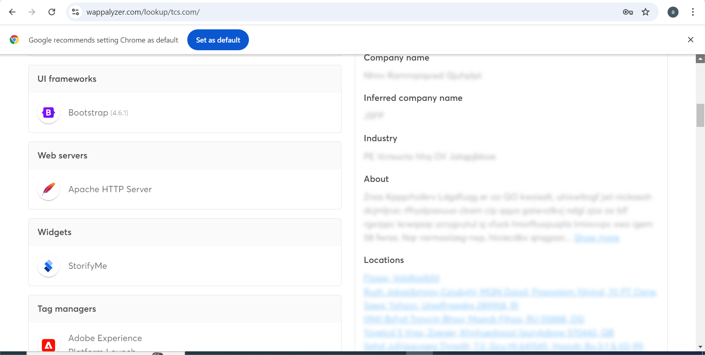

Slide 13
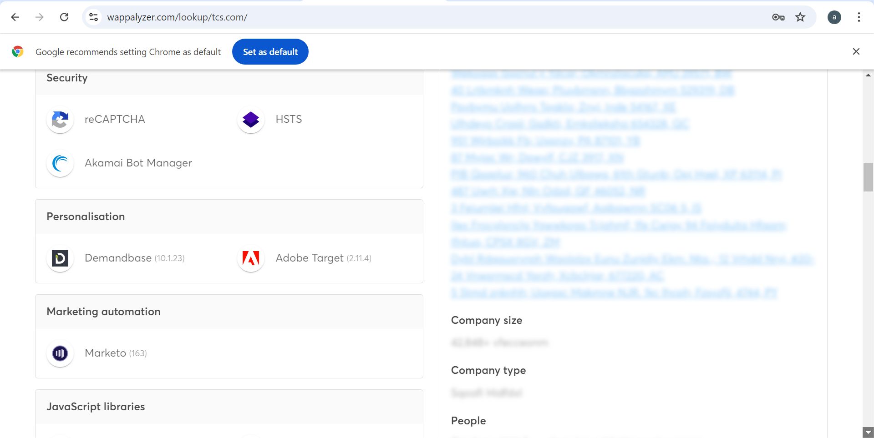

Slide 14
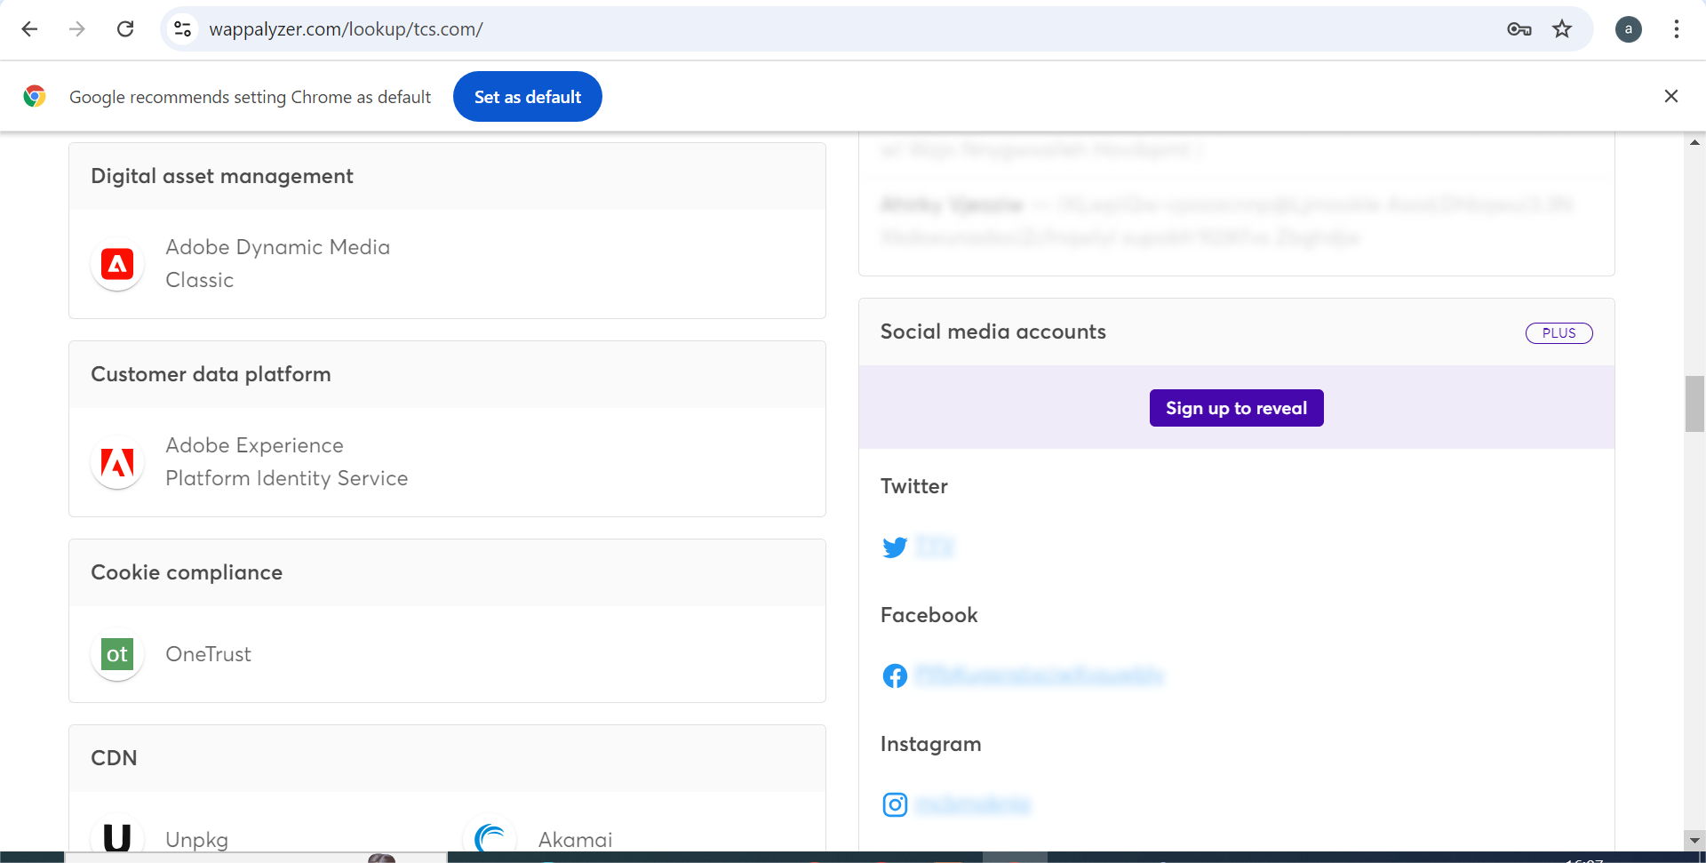

Slide 15
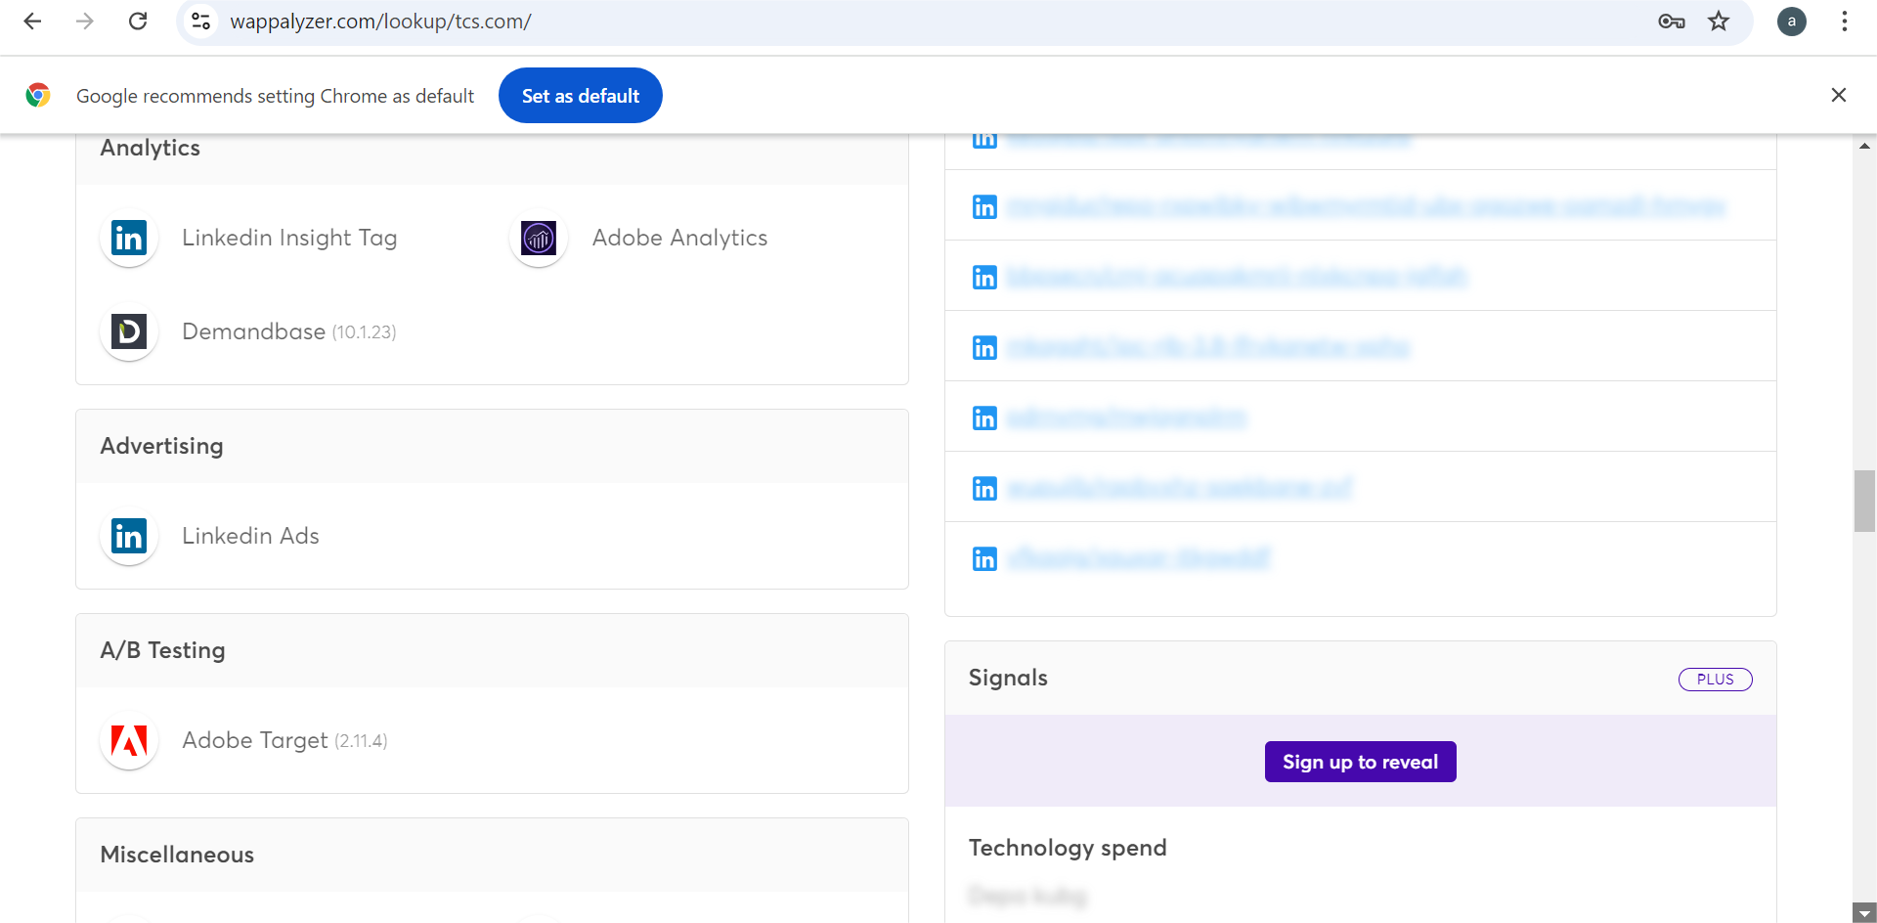

Slide 16
Responsive Design Testing
Cloud
CLICK HERE
Artificial Intelligence
CLICK HERE
EnterpriseS olutions
CLICK HERE
CLICK HERE
Consulting
Data & Analytics
CLICK HERE

Slide 17
Website Mistakes Identification
Slow loading times.
A website that is not progress for mobile devices can lead to a poor user experience.
some common problems that users might encounter on e-commerce websites.
Insufficient product details :•Not providing enough information about products can make it difficult for users to make informed decisions.
A complicated checkout process can deter users from completing their purchases.

Slide 18
Best Practices List
•
Mobile-first design:
Ensure the website is optimized for mobile devices, as a significant portion of online shopping occurs on smartphones and tablets.
•
Fast page load times:
Use techniques like image optimization, caching, and content delivery networks to improve website speed.
Checkout process:
Keep the checkout process simple and streamlined, offering multiple payment options and clear shipping information.

Slide 19
Customer support:
Provide multiple channels for customer support, such as live chat, email, and phone.
Social media integration:
Use social media platforms to engage with customers, promote products, and drive traffic to the website.
•
Email marketing:
Build an email list and send targeted campaigns to nurture customer relationships and promote sales.
•
Content marketing:
Create high-quality content, such as blog posts, product reviews, and tutorials, to attract and engage visitors.

Slide 20
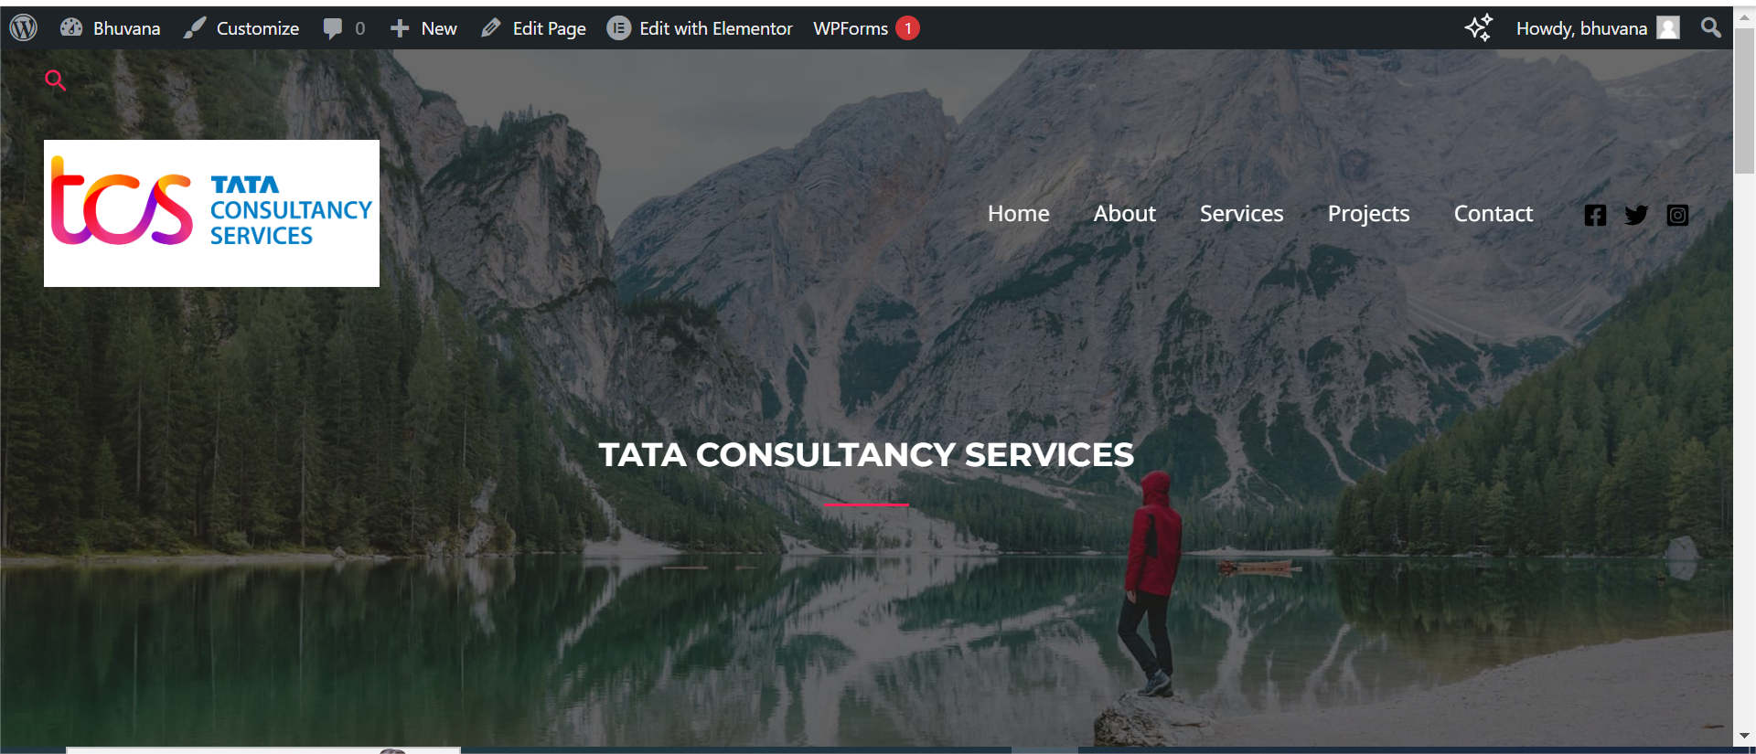
Website Design

Slide 21
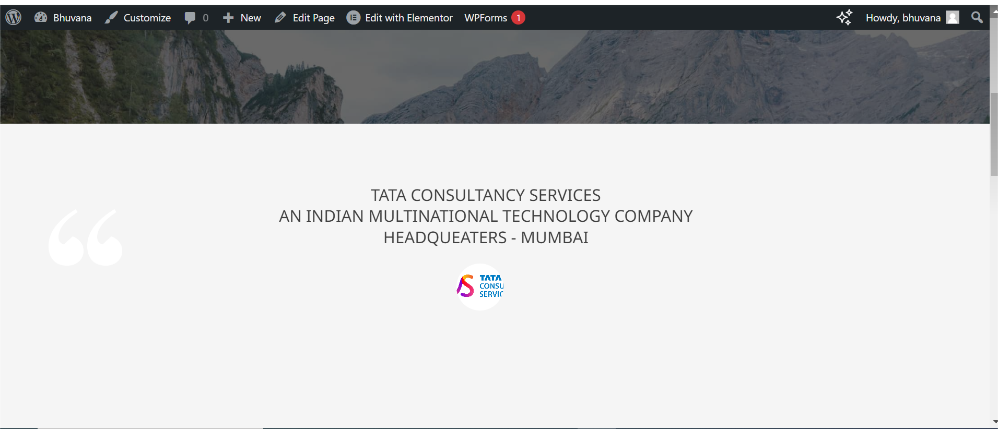
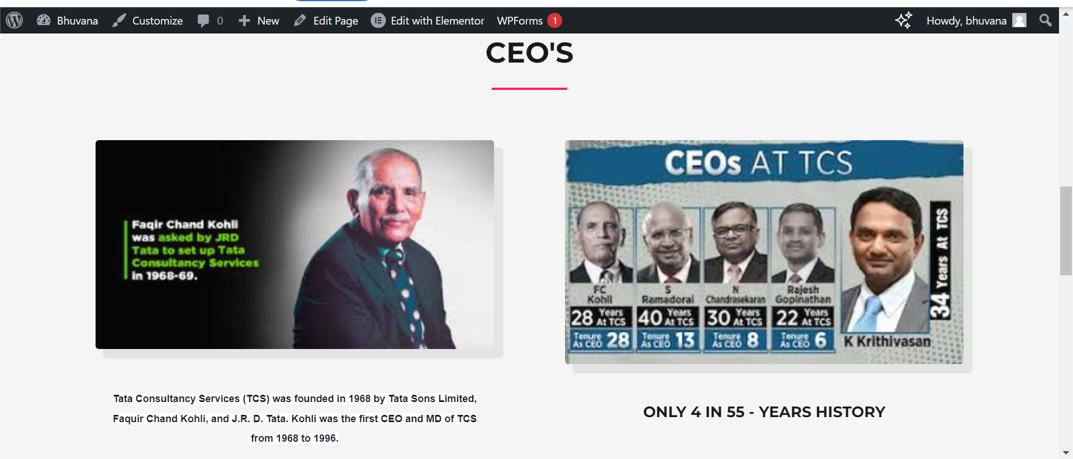

Slide 22
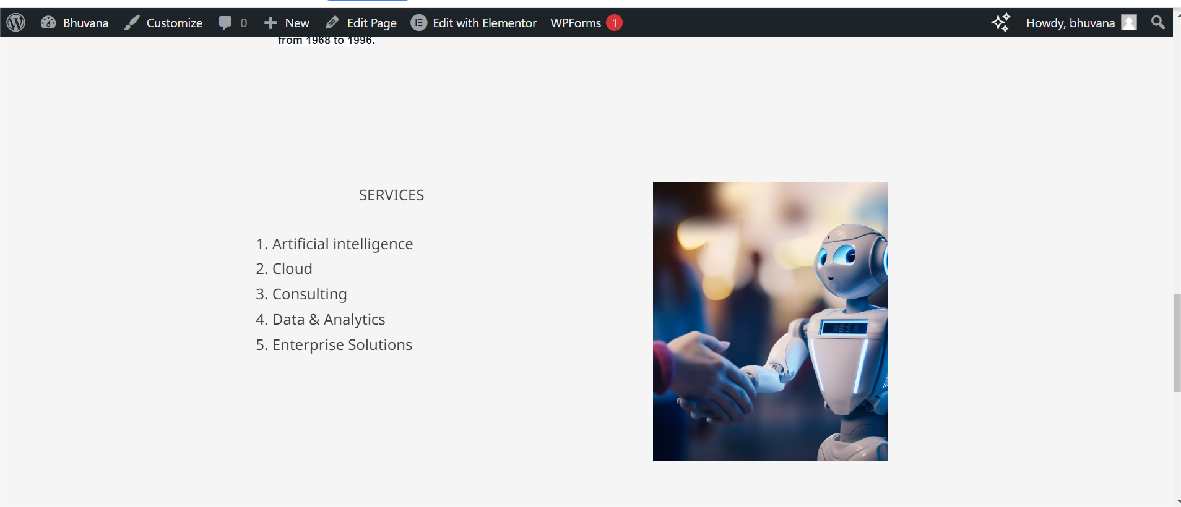
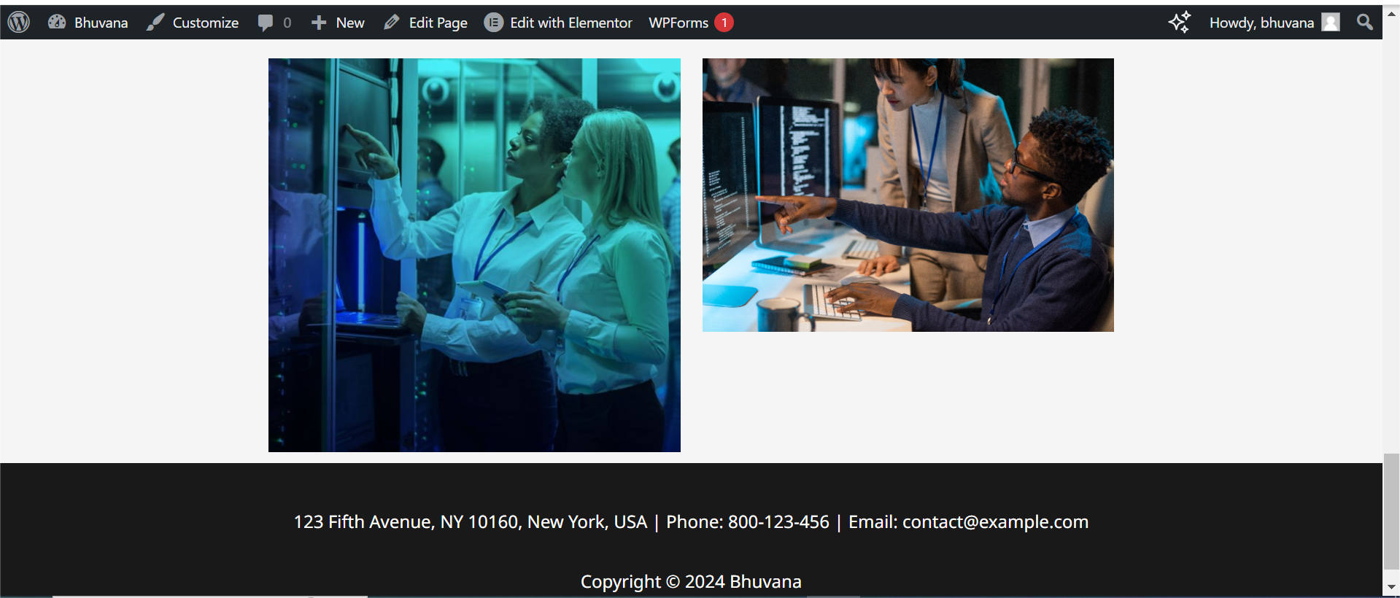

Slide 23
THANK YOU
ALL IS WELL

